Slide 1
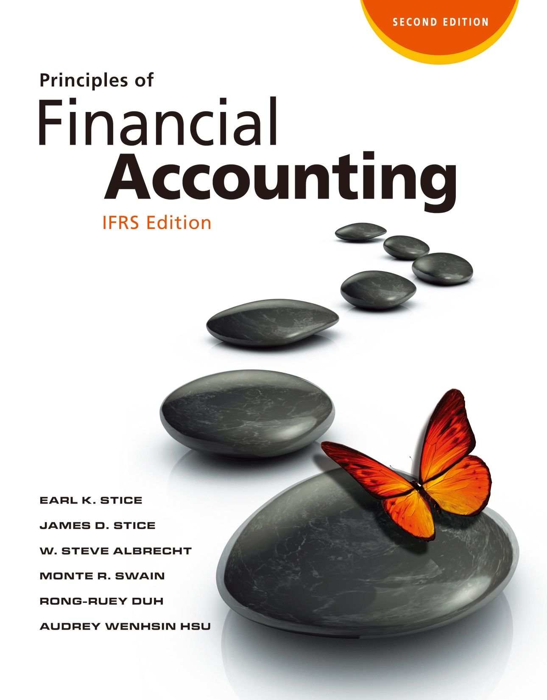

Slide 2
Receivables

Slide 3
Types of Receivables
Types of Receivables
LO1
Receivable: Claims for money, goods, or services
Accounts Receivable: A current asset representing money due for services performed or merchandise sold on credit.
Notes Receivable: A contract in the form of a note received by a company and written by its customer as a result of the company’s selling goods or providing services to the customer on credit.

Slide 4
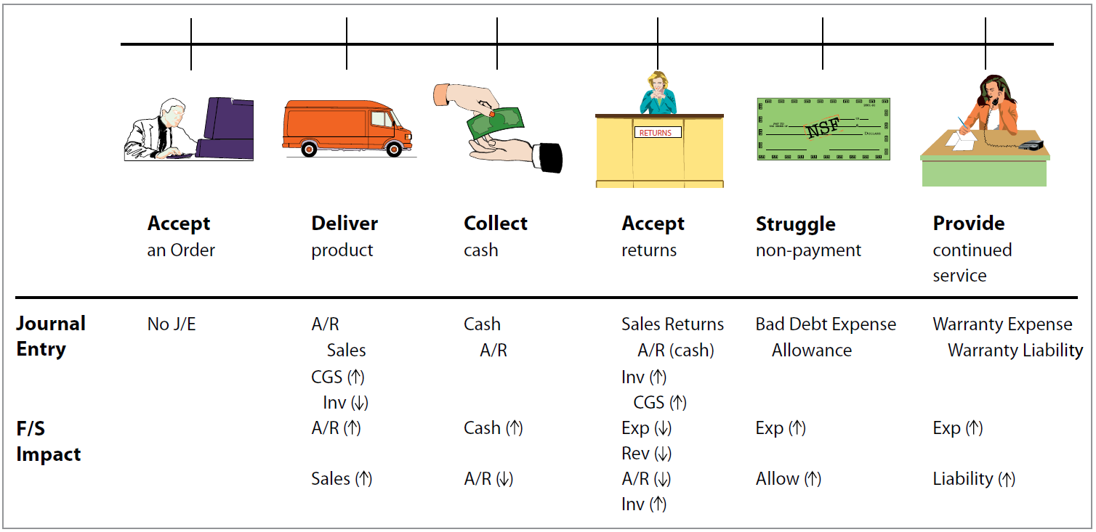
Types of Receivables
LO1
Activity: Selling a Product or Service
Exhibit 6.2

Slide 5
Revenue Recognition
Accounts Receivable
LO2
According to IAS 18, when a company (a reporting entity) provides goods to its customers, it must satisfy all the conditions in order to recognize revenue:
The entity has transferred to the buyer the significant risks and rewards of ownership of the goods
The entity retains neither continuing managerial involvement to the degree usually associated with ownership nor effective control over the goods sold
The amount of revenue can be measured reliably
It is probable that the economic benefits associated with the transaction will flow to the entity
The costs incurred or to be incurred in respect of the transaction can be measured reliably

Slide 6
Revenue Recognition
LO2
In the case of provision of services, IAS 18 also provides criteria for revenue recognition as follows:
The amount of revenue can be measured reliably
It is probable that the economic benefits associated with the transaction will flow to the entity
The stage of completion of the transaction at the end of the reporting period can be measured reliably
The costs incurred for the transaction and the costs to complete the transaction can be measured reliably

Slide 7
Accounting for Cash Collection and Accounts Receivable
LO2
Illustration
Hop Pot Bakery sold 30 jars of jam for cash and 20 jars of jam on credit at NT$10 each, Hot Pot Bakery recorded the sales as follows:
Cash
300
Accounts Receivable
200
Sales Revenue
500
Sold 30 jars of jam for cash and 20 jars on credit.

Slide 8
Accounting for Cash Collection and Accounts Receivable
LO2
Illustration
At the same time, another journal entry was recorded to reflect the decrease in inventory by NT$400.
Subsequent collection of the NT$200 accounts receivable is recorded as follows:
Cost of Goods Sold
400
Inventory
400
To record the decrease in inventory and to recognize the cost of goods sold.
Cash
200
Accounts Receivable
200
Collected cash for NT$200 credit sale.

Slide 9
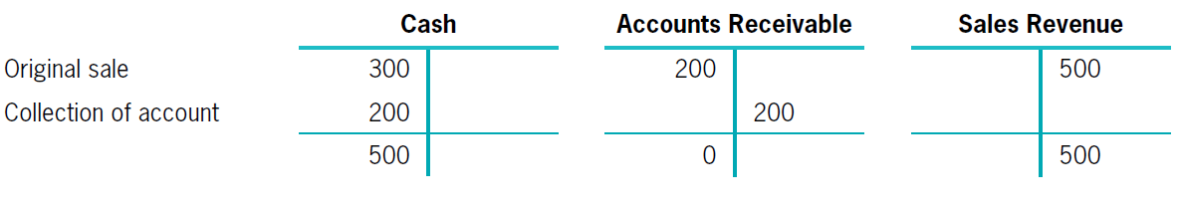
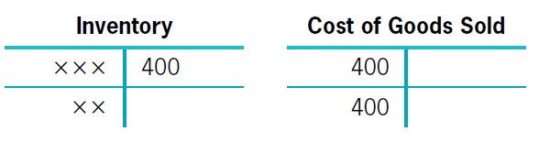
Accounting for Cash Collection and Accounts Receivable
LO2
Illustration
The following T-accounts show the net result of these two transactions:

Slide 10
Sales Discounts
LO2
A reduction in the selling price allowed if payment is received within a specified period.
Illustration
If the NT$200 in Hot Pot Bakery credit sales were made with discount terms of 2/10, n/30, and if the customer paid within the discount period.
Sales Discounts is a contra-revenue account (deducted from sales).
Cash
196
Sales Discounts (NT$200 x 0.02)
4
Accounts Receivable
200
Collected cash within the discount period for $200 credit sale.

Slide 11
Sales Returns and Allowances
LO2
Customers often return merchandise, either because the item is defective or for a variety of other reasons.
Illustration
Assume that before any payments on account are made, Hot Pot Bakery customers return goods that were sold to them at NT$150; NT$100 in returns were made by cash customers, and NT$50 in returns were made by credit customers.
Sales Returns and Allowances
150
Cash
100
Accounts Receivable
50
Received NT$150 of returned merchandise; NT$100 from cash
customers and NT$50 from cash customers.

Slide 12
Sales Returns and Allowances
LO2
Illustration
The cost of the returned goods was NT$120.
Sales Returns and Allowances is also a contra account (deducted from sales).
Inventory
120
Cost of Goods Sold
120
To record the increase in inventory and the decrease in Cost of
Goods Sold due to the return of goods.

Slide 13
Sales Returns and Allowances
LO2
Illustration
Assuming payment within the discount period on the NT$150 balance in Accounts Receivable, statement of comprehensive income for the revenue accounts is as follows.
Statement of Comprehensive income (partial) | Units: NT dollars
Sales revenue | $500
Less: Sales discount | (3)
Less: Sales returns and allowances | (150)
Net Sales revenue |  | $347
*(NT$200 – NT$50) × 0.02 = NT$3
Note that when merchandise is returned, sales discount for the subsequent payment are granted only on the selling price of the merchandise not returned.

Slide 14
Gross Sales and Net Sales
LO2
Gross Sales
Total recorded sales before sales discounts and sales returns and allowances.
Net Sales
Gross sales less sales discount and sales returns and allowances.
Gross Sales
- Sales Discounts
- Sales Returns and Allowances
= Net Sales

Slide 15
Quiz Yourself
LO2
Hendrix Company had $100,000 and $40,000 in credit and cash sales, respectively, during the month. The cost to Hendrix for the goods sold was $112,000.
Customers who purchased on credit received sales discounts totaling $2,700 when paying for $90,000 of the goods purchased. The balance will be paid in the following month.
In addition, $4,500 in merchandise was returned (all from customers who purchased using cash). The cost of the returned merchandise was $3,600.
Provide all the journal entries for the month relating to these transactions and compute net sales for the month.

Slide 16
Quiz Yourself
LO2
Solution:
Cash
40,000
Accounts Receivable
100,000
Sales
140,000
Cost of Goods Sold
112,000
Inventory
112,000
Cash
87,300
Sales Discounts
2,700
Accounts Receivable
90,000
Sales Returns
4,500
Cash
4,500
Inventory
3,600
Cost of Goods Sold
3,600

Slide 17
Quiz Yourself
LO2
Solution:
Gross Sales ..............................................
$140,000
Less: Sales discounts ...............................
(2,700)
Less: Sales returns ..................................
(4,500)
Net sales ..................................................
$132,800

Slide 18
Valuing Receivables
Valuing and Reporting Receivables
LO3
Bad Debts
An uncollectible accounts receivable.
The Direct Write-Off Method
Record actual losses from uncollectible accounts as expenses during the period in which accounts receivable are determined to be uncollectible.
The Allowance Method
Record the impairment of accounts receivable before they actually happened.
Violate the GAAP.

Slide 19
The Allowance Method
LO3
Illustration
Assume that Hot Pot Bakery estimated that due to the economic downturn and financial difficulties of its customers, the value of accounts receivable is impaired by NT$4,500.
A selling expense on the statement of comprehensive income.
Bad Debt Expense
4,500
Allowance for Bad Debts
4,500
To record the estimated bad debt expense for the current year.
A contra account to Accounts Receivable.

Slide 20
The Allowance Method
LO3
Illustration
If in 2018, Jake Palmer’s receivable for NT$1,500 is specifically identified as being uncollectible. Actual losses are recognized, the balance in Allowance for Bad Debts is reduced.
Allowance for Bad Debts
1,500
Accounts Receivable
1,500
To write off the uncollectible account of Jake Palmer.

Slide 21
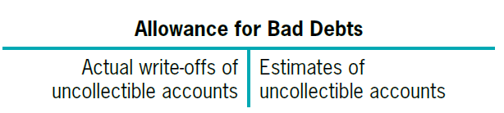
The Allowance Method
LO3
Illustration
The net amount in Accounts Receivable after the NT$1,500 write-off is exactly the same as it was before the entry.
Before Write-Off Entry |  | After Write-Off Entry
Accounts receivable | NT$50,000 | Accounts receivable (NT$50,000-NT$1,500) | NT$48,500
Less allowance for bad debts | 4,500 | Less allowance for bad debts (NT$4,500-NT$1,500) | 3,000
Net balance | NT$45,500 | Net balance | NT$45,500
net realizable value of accounts receivable

Slide 22
The Allowance Method
LO3
Reverse the Write-off Entry
A customer whose account has been written off as uncollectible later pays the outstanding balance.
Illustration
Assume that Jake Palmer pays the NT$1,500 after his account has already been written off.
Accounts Receivable
1,500
Allowance for Bad Debts
1,500
To reinstate the balance previously written off as uncollectible.
Cash
1,500
Accounts Receivable
1,500
Received payment in full previously written-off accounts receivable.

Slide 23
Estimating Uncollectible Accounts Receivable
LO3
Percentage of Total Receivables
The amount of uncollectible is a percentage of the total receivables balance at the end of the period.
Illustration
Hot Pot Bakery estimates that 12% of the NT$50,000 in the year-end Accounts Receivable is uncollectable.
The value of accounts receivable
NT$44,000 (NT$50,000 × 0.88)
The credit balance in Allowance for Bad Debts
NT$6,000 (NT$50,000 × 0.12)

Slide 24
Estimating Uncollectible Accounts Receivable
LO3
Illustration
If there is no existing balance in Allowance for Bad Debts from prior year:
If there is an existing credit balance of NT$2,000 in Allowance for Bad Debts:
Bad Debt Expense
6,000
Allowance for Bad Debts
6,000
To adjust the allowance account to the desired balance
(NT$6,000 – 0 = NT$6,000).
Bad Debt Expense
4,000
Allowance for Bad Debts
4,000
To adjust the allowance account to the desired balance
(NT$6,000 – NT$2,000 = NT$4,000).

Slide 25
Estimating Uncollectible Accounts Receivable
LO3
Aging Accounts Receivable
Each receivable is categorized by the number of days it has been outstanding.
Each total is multiplied by an appropriate uncollectible percentage, recognizing that the older the receivable, the less likely the company is to collect.

Slide 26
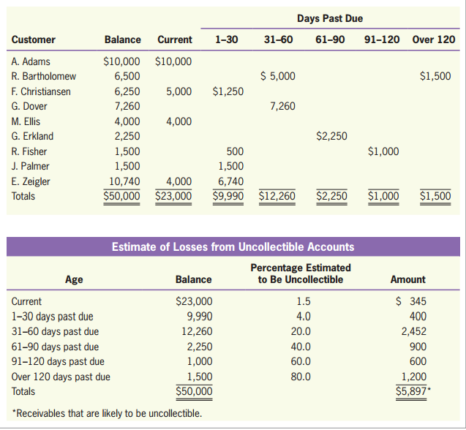
Estimating Uncollectible Accounts Receivable
LO3
Illustration
Exhibit 6.3

Slide 27
Estimating Uncollectible Accounts Receivable
LO3
Illustration
If the existing credit balance in Allowance for Bad Debts is NT$2,000, the required adjusting entry is:
Bad Debt Expense
3,897
Allowance for Bad Debts
3,897
To adjust the allowance account to the desired ending balance
(NT$5,897 – NT$2,000 = NT$3,897).

Slide 28
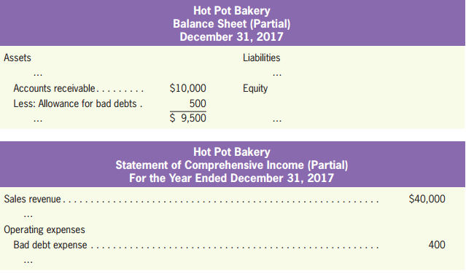
Presentation on Financial Statements
LO3

Slide 29
Quiz Yourself
LO3
Sales on account for the period totaled $500,000. The allowance for bad debts account had a balance at the beginning of the year of $14,500. Accounts Receivable written off as uncollectible during the year totaled $12,300.
Compute bad debt expense for the period assuming the following:
An aging of accounts receivables estimates that $16,000 will prove uncollectible.

Slide 30
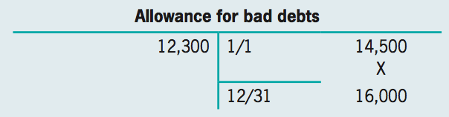
Quiz Yourself
LO3
Solution
Beginning balance of allowance for bad debts
+ Bad debt expense
– Actual write-offs
= Ending balance of allowance for bad debts
$14,500 + Bad debt expense – $12,300 = $16,000
→ Bad debt expense = $13,800

Slide 31
Ratios Assessing Companies’ Receivables
Assessing How Well Companies Manage Their Receivables
LO4
Accounts Receivable Turnover
A measure used to indicate how fast a company collects its receivables.
Sales Revenue
Accounts Receivable Turnover =
Average Accounts Receivable
€76,495 millions
Carrefour:
= 34 times
€2,265 millions
€24,244 millions
Philips:
= 5.3 times
€4,602 millions

Slide 32
Ratios Assessing Companies’ Receivables
LO4
Average Collection Period
A measure of the average number of days it takes to collect a credit sale.
365
Average Collection Period =
Accounts Receivable Turnover
365
Carrefour:
= 10.7 days
34 times
365
Philips:
= 68.9 days
5.3 times

Slide 33
Quiz Yourself
LO4
Compute the average collection period for Google for 2015 given sales for 2015 of $74,989 million and beginning and ending Accounts Receivable balances of $11,556 million and $9,383 million, respectively.
Solution
$74,989 ÷ [($11,556 + $9,383) ÷ 2] = 7.16 times
365 days ÷ 7.16 = 50.98 days

Slide 34
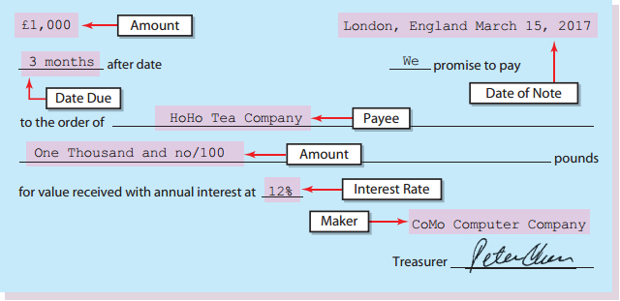
Notes Receivable
Notes Receivable
LO5
Companies can also grant credit by a promissory note, a formal credit instrument that has a stronger legal claim.

Slide 35
Notes Receivable
LO5
Characteristics of Notes Receivable
The face amount: the amount that is written on the note
The Issuance date: the date when the note is issued
The Due date or Maturity date: when the note is to be paid
Interest: the interest rate is often presented on the annual basis
Interest revenue = Face value × Annual interest rate × The term of the note

Slide 36
Notes Receivable
LO5
Illustration
Assume that HoHo Tea Co. accepted a 90-day, 12% note that is dated May 1, 2017, to settle an open account of accounts receivable from CoMo Computer Co., which has a balance of £5,000.
The entry is recorded as follows:
May 1
Notes Receivable-CoMo
5,000
Accounts Receivable-CoMo
5,000
To settle accounts receivable with notes receivable.

Slide 37
Notes Receivable
LO5
Illustration
On July 30, 2017, the due date, HoHo Tea Co. records the receipt of £5,150 from CoMo Computer Co.
£5,000 × 12% × 3 months/12 months = £150
Jul. 30
Cash
5,150
Notes Receivable-CoMo
5,000
Interest Revenue
150
To record receipt of face amount and interest of a note receivable.

Slide 38
Notes Receivable
LO5
Illustration
If HoHo Tea Co. has not received cash from CoMo Computer on July 30, the note becomes a dishonored note receivable.
Transfer the face amount of the note plus the interest into an accounts receivable account
Jul. 30
Accounts Receivable-CoMo
5,150
Notes Receivable-CoMo
5,000
Interest Revenue
150
To transfer a dishonored note receivable to an account receivable.
The company still earns the interest revenue.

Slide 39
Quiz Yourself
LO5
Suppose Pearl Company accepted a two-month, 12% note dated August 1, 2017 to settle an open account of accounts receivable $1,000 from its customer, Rock Company. On October 1, 2017, Pearl received cash $1,020 from Rock.
Prepare journal entries for the above transactions.
Aug. 1
Notes Receivable-Rock
1,000
Accounts Receivable-Rock
1,000
To settle accounts receivable with notes receivable.
Oct. 1
Cash
1,020
Notes Receivable-Rock
1,000
Interest Revenue
20
To record receipt of face amount and interest of a note receivable.

Slide 40
Quiz Yourself
LO5
Suppose that the note was dishonored on October 1, 2017, and Pearl was charged $5 by a bank due to this event. Prepare journal entries.
Oct. 1
Accounts Receivable-Rock
1,025
Notes Receivable-Rock
1,000
Interest Revenue
20
Cash
5
To transfer a dishonored note receivable to an account receivable.

